Slide 1

The techniques of CNN in TensorFlow
Notes:
‹#›

Slide 2
Objectives
Understanding ImageDataGenerator
Defining a ConvNet to use complex images
Train the ConvNet with ImageDataGenerator
Exploring the impact of compressing images
The techniques of CNN in TensorFlow
‹#›

Slide 3
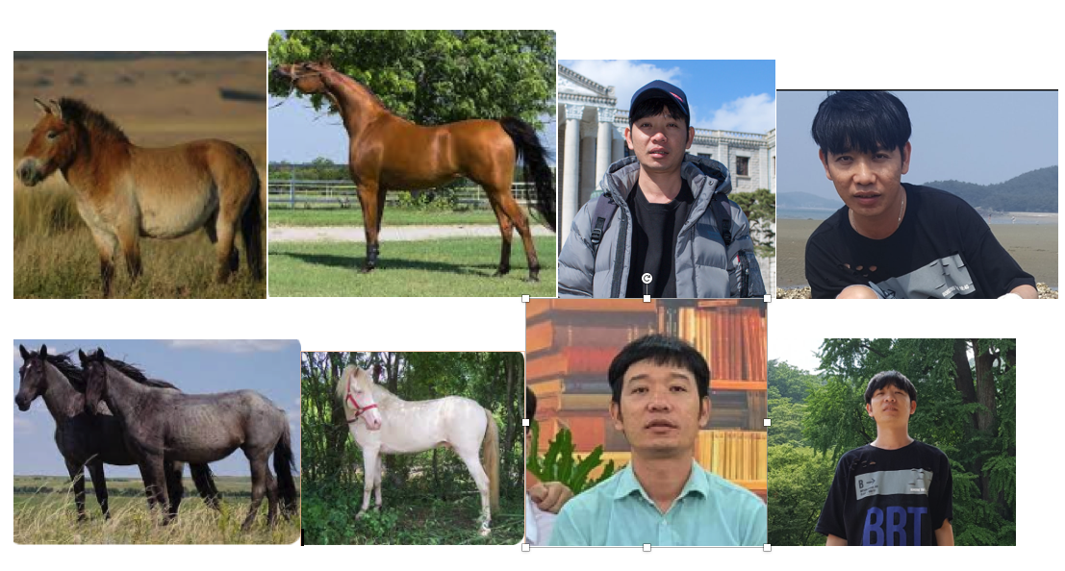
ImageDataGenerator
What happens when you use larger images and where the feature might be in different locations?
They have different sizes and different aspect ratios. The subject can be in different locations. In some cases, there may even be multiple subjects
The techniques of CNN in TensorFlow
‹#›
Notes:
‹#›

Slide 4
ImageDataGenerator
You can point it at a directory and then the sub-directories of that will automatically generate labels for you
You have an images directory and in that, you have sub-directories for training and validation. When you put sub-directories in these for horses and humans and store the requisite images in there, the image generator can create a feeder for those images and auto label them for you.
The techniques of CNN in TensorFlow
‹#›
Notes:
‹#›

Slide 5
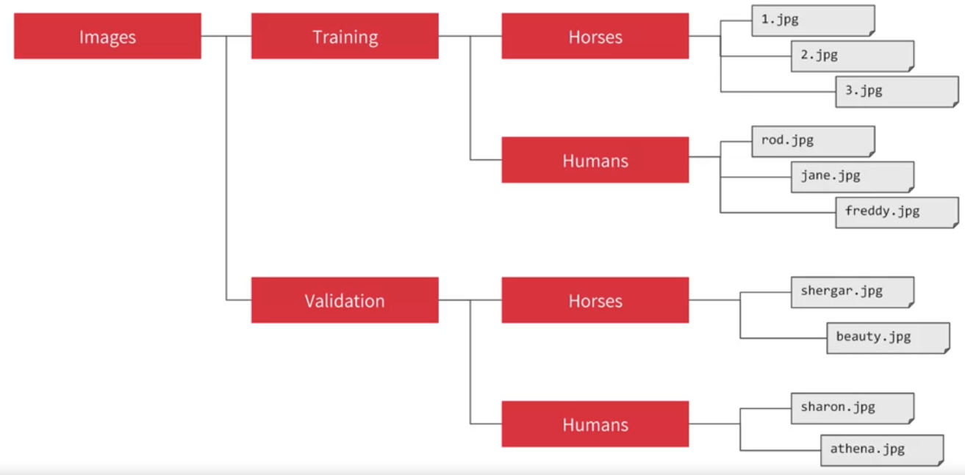
ImageDataGenerator
If you point an image generator at the training directory, the labels will be horses and humans and all of the images in each directory will be loaded and labeled accordingly.
The techniques of CNN in TensorFlow
‹#›
Notes:
‹#›

Slide 6
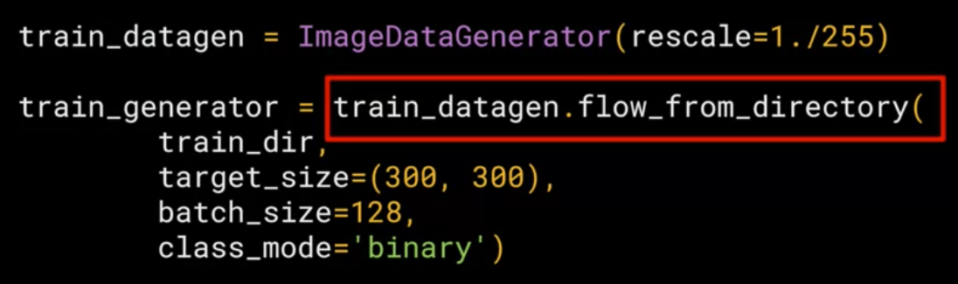
ImageDataGenerator
The image generator class is available in Keras.preprocessing.image.
Rescale to it to normalize the data
The techniques of CNN in TensorFlow
‹#›
Notes:
‹#›

Slide 7
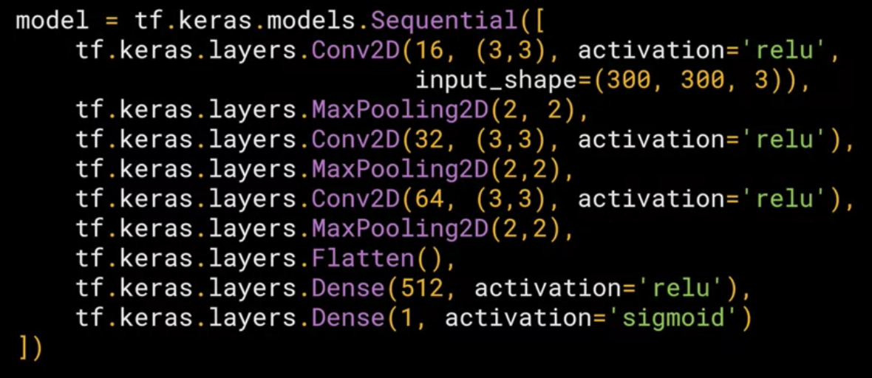
Defining a ConvNet to use complex images
Discuss and give your opinions
The techniques of CNN in TensorFlow
‹#›
Notes:
‹#›

Slide 8
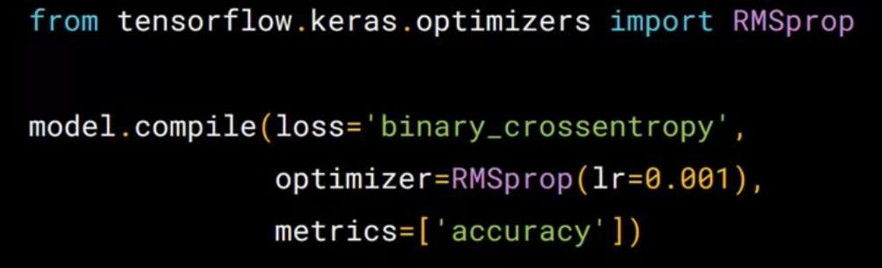
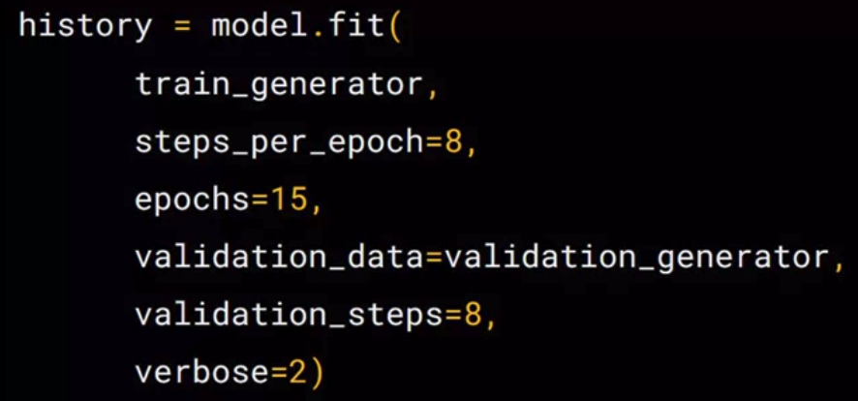
Training the ConvNet
The techniques of CNN in TensorFlow
‹#›
Notes:
‹#›

Slide 9
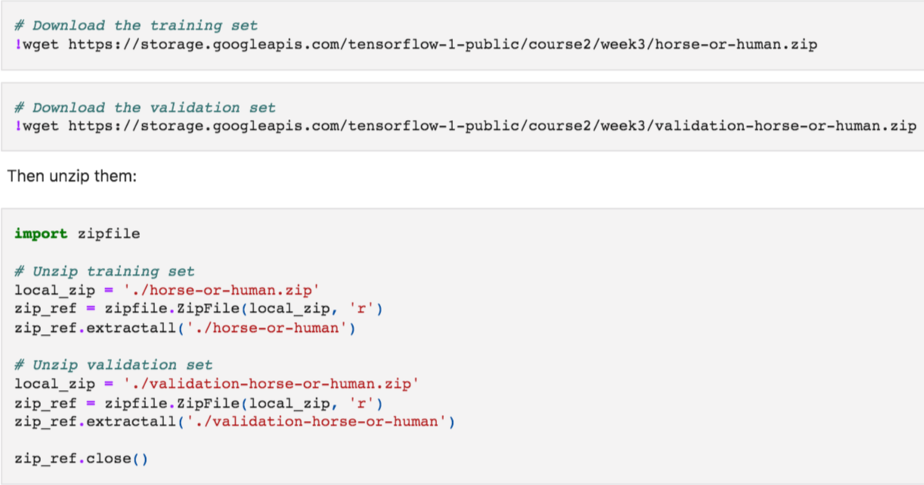
Impact of compressing images
Reducing the target size of the generator images will affect the architecture and performance of your model.
The techniques of CNN in TensorFlow
‹#›
Notes:
‹#›

Slide 10
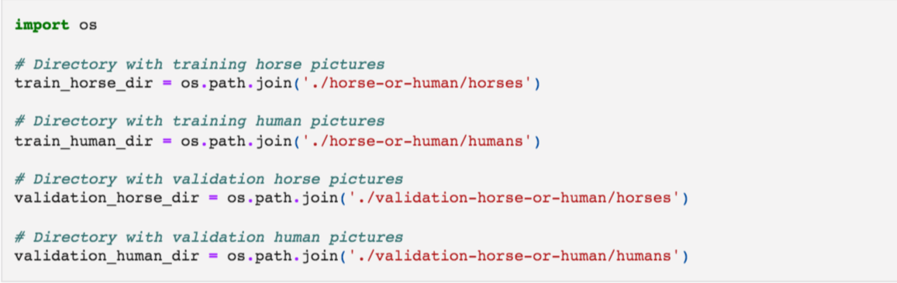
Impact of compressing images
Then define the directories containing the images:
The techniques of CNN in TensorFlow
‹#›
Notes:
‹#›

Slide 11
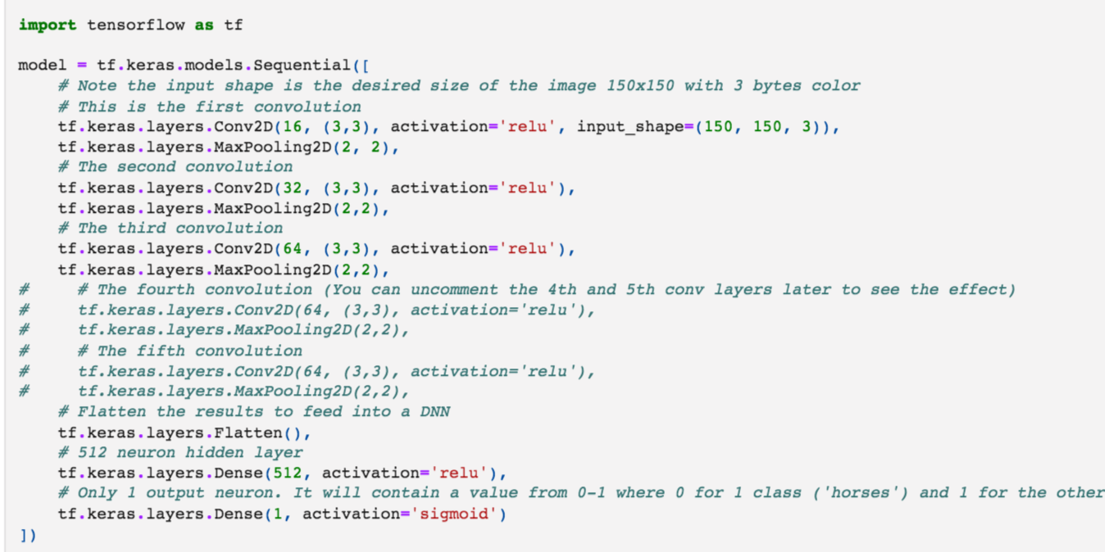
Impact of compressing images
Build model
The techniques of CNN in TensorFlow
‹#›
Notes:
‹#›

Slide 12
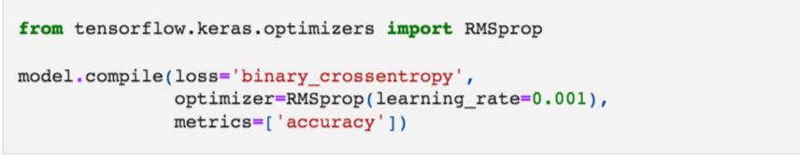
Impact of compressing images
Setting for training
The techniques of CNN in TensorFlow
‹#›
Notes:
‹#›

Slide 13
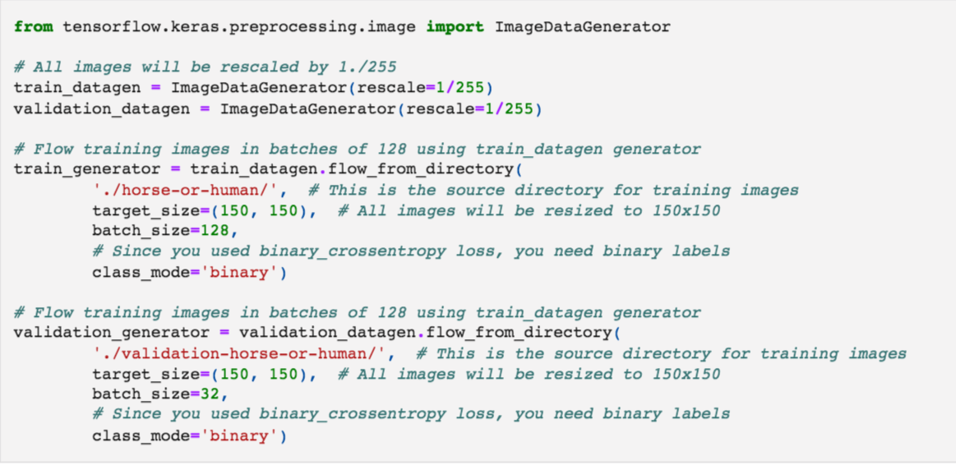
Impact of compressing images
Data preprocessing
The techniques of CNN in TensorFlow
‹#›
Notes:
‹#›

Slide 14
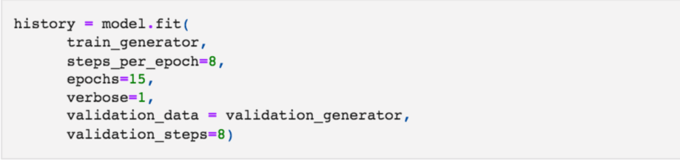
Impact of compressing images
Training
The techniques of CNN in TensorFlow
‹#›
Notes:
‹#›

Slide 15
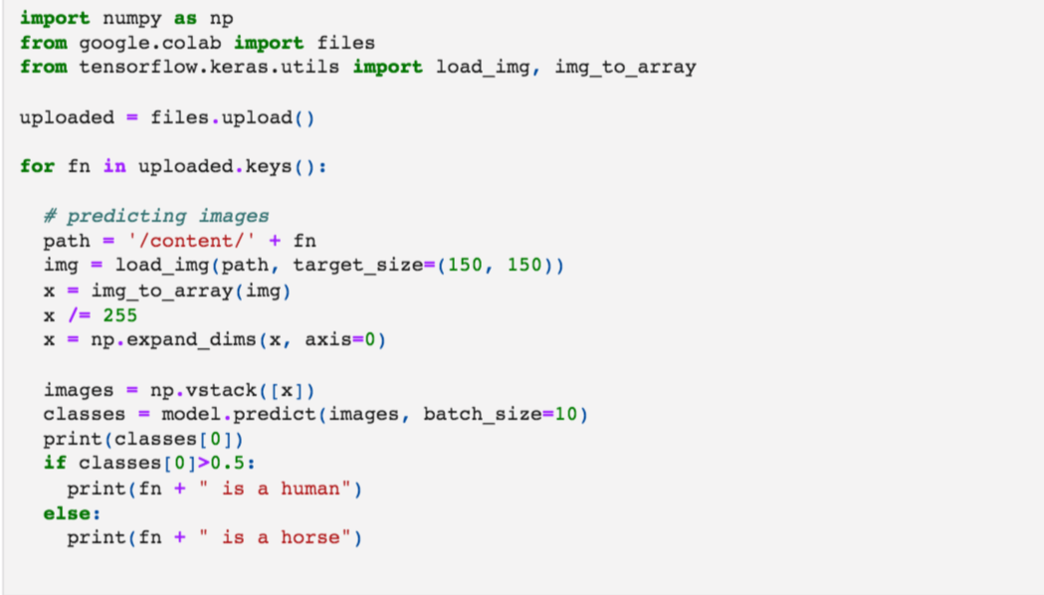
Impact of compressing images
Model prediction
The techniques of CNN in TensorFlow
‹#›
Notes:
‹#›

Slide 16
Summary
Understanding ImageDataGenerator
Defining a ConvNet to use complex images
Train the ConvNet with ImageDataGenerator
Exploring the impact of compressing images
The techniques of CNN in TensorFlow
‹#›

Slide 17
Q & A
The techniques of CNN in TensorFlow
‹#›

